Slide 1


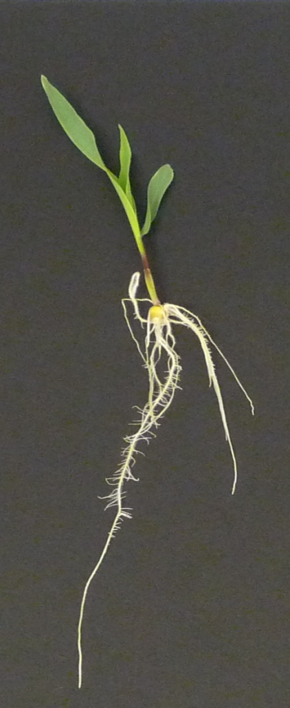
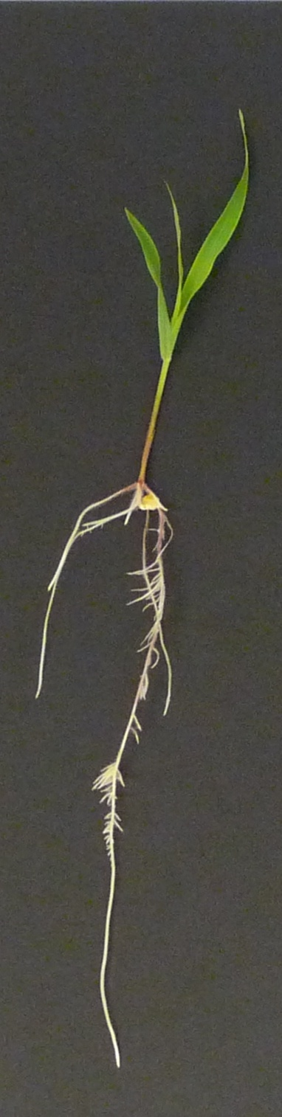
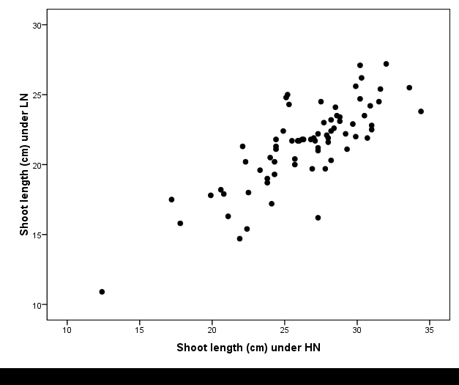
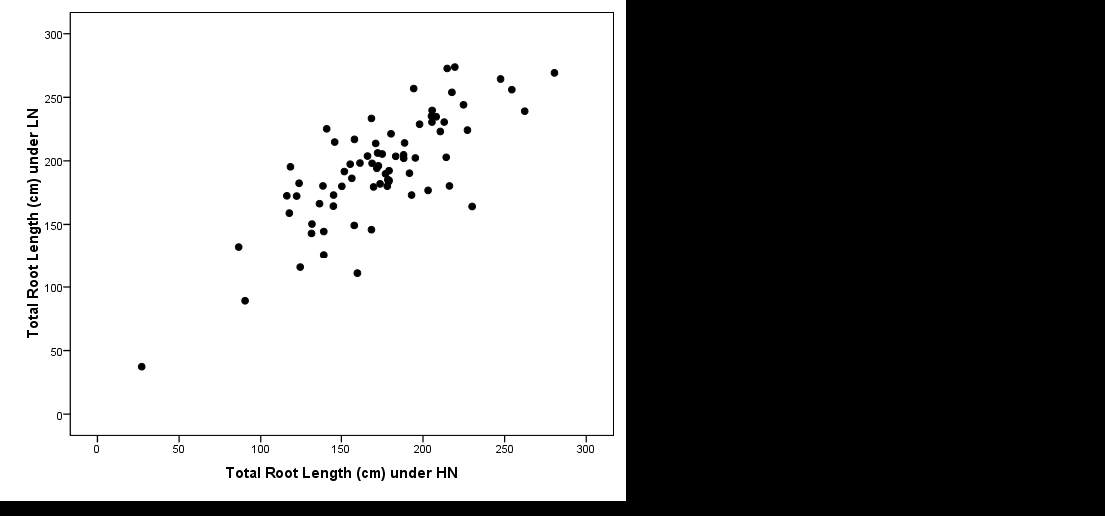
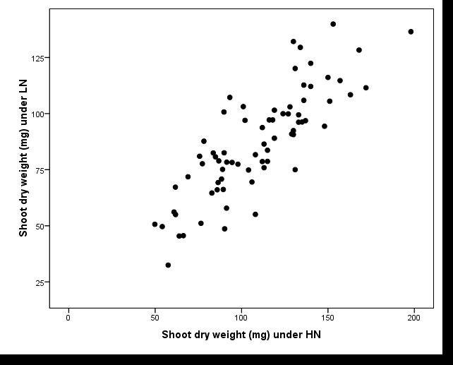
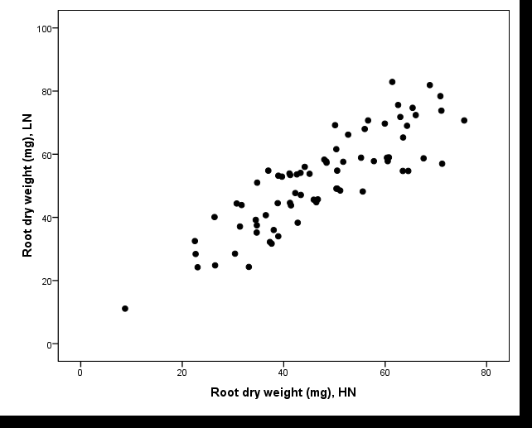
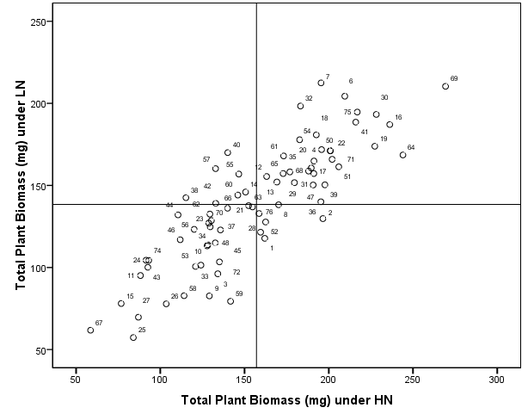
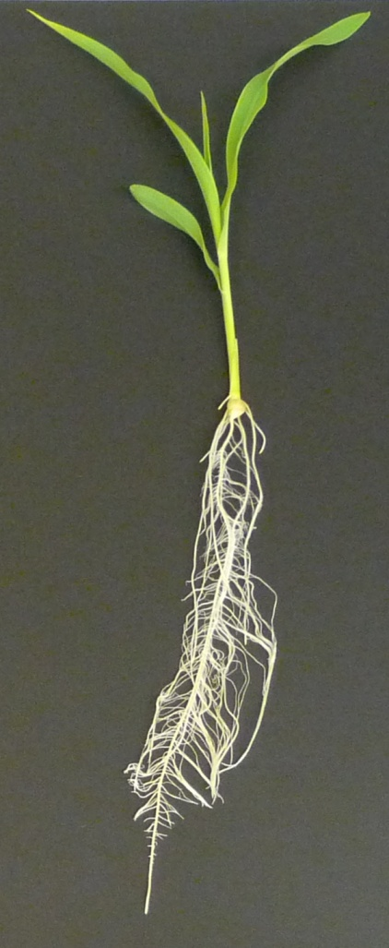
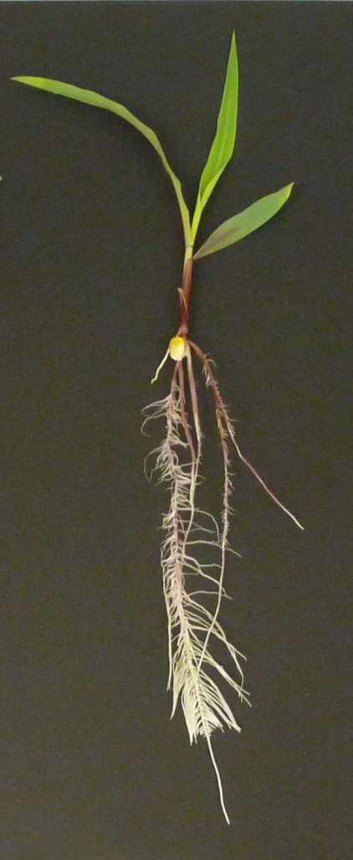
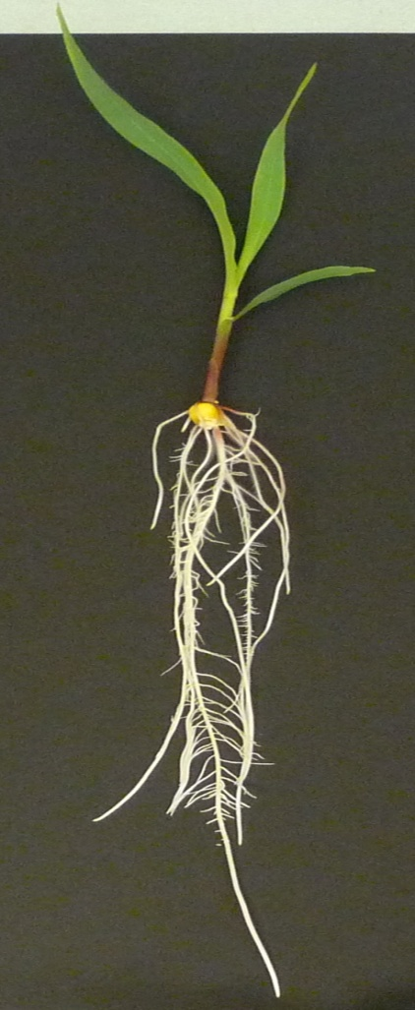
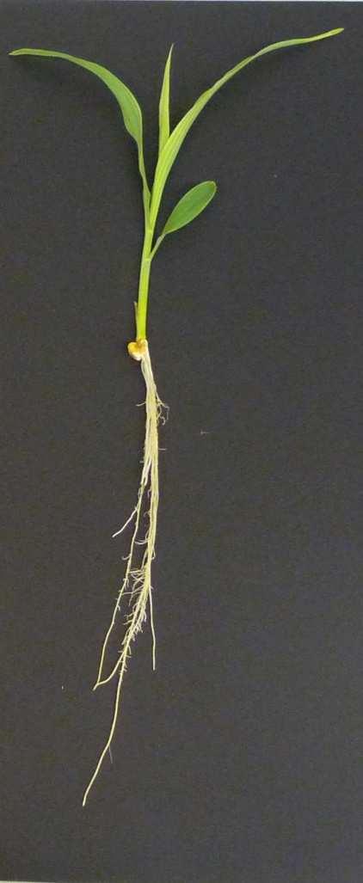
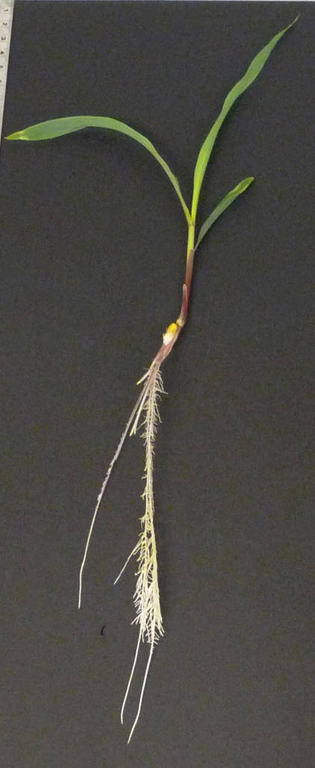
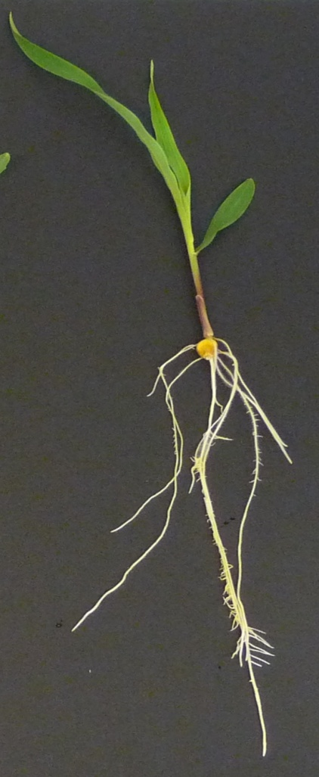
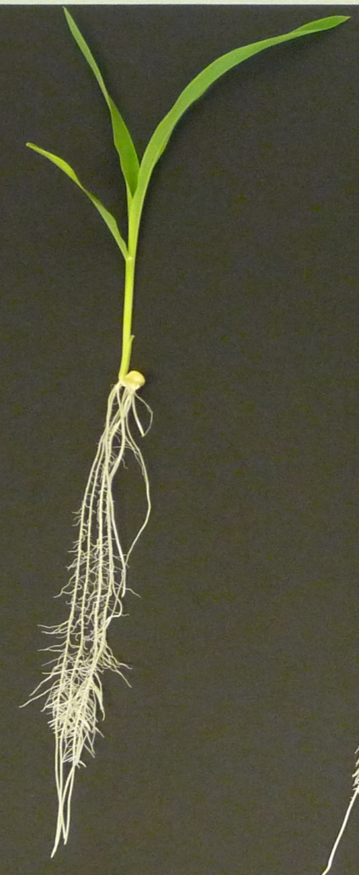
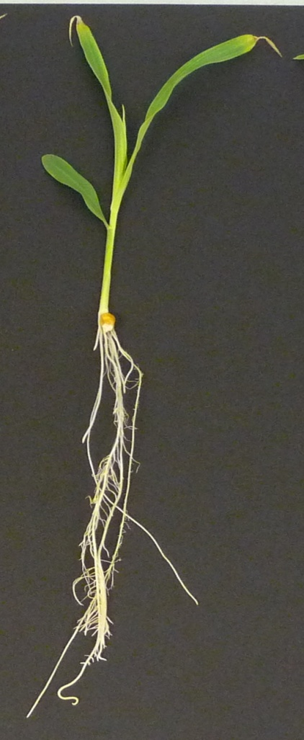
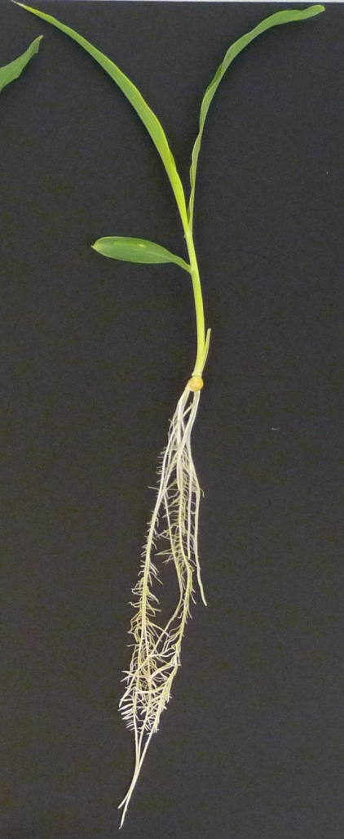
Response of expired plant variety protection lines and public inbred lines to nitrogen at seedling stage
Bharath Kumar*, Adel H. Abdel-Ghani, Jenaro M Reyes Matamoros, Thomas Lübberstedt
Department of Agronomy, Iowa State University, Ames, IA 50011, USA
*email: nbharath@iastate.edu
Introduction
Nitrogen (N) is a key macro-element in maize production. Plant breeders are concerned to improve nitrogen use efficiency (NUE) in maize to help reducing extensive N application and, consequently, costs and N losses into the environment (Zhang et al. 1997). High levels of variation among genotypes in N uptake and N use efficiency have been reported among maize lines based on grain yield data (Uribelarrea et al. 2004). However, little attention has been given to root related traits as a selection criterion to improve NUE (Tuberosa and Salvi 2007). The current study was aimed at studying the genotypic variation in a diverse set of maize inbred lines composed of 44 expired plant variety protection (PVP) lines and 30 public inbred lines for sixteen root traits possibly having influence on NUE.
Table 1: Estimates of broad sense heritabilities for 16 seedling attributes of 74 maize lines combined over experiments.
Figure 4b: Non-efficient/non-responder lines under high and low nitrogen condition.
Under Low N
Under High N
Fig. 2: Phenotypic correlation coefficients between seedling attributes for the high and low nitrogen (N) treatments.
** Significant at P=0.01
HP301
FR19
HP301
FR19
Results
In our study, maize lines exhibited an adaptive mechanism to N deficit by displaying an increased shoot biomass at HN level and increased root attributes at LN level (Fig. 1).
Higher heritability values under LN than under HN (Table 1) and strong associations of traits under HN and LN level (Fig.2) indicates that direct selection under LN conditions is more efficient to improve N-use efficiency than indirect selection at HN.
In view of the positive correlations for SDW and RDW with other shoot and root attributes (data not shown), combined with high heritability values for these traits (Table 1), it can be concluded that direct selection for SDW and RDW per se would be effective to screen lines for high NUE performance.
Based on the response of TPB to N supply, efficient/responder and non-efficient/non-responder lines were identified (Fig.3). Efficient/responder lines have high plant biomass under both N levels (Fig.4a), whereas non-efficient/non-responder lines have low plant biomass under both N levels (Fig.4b). These lines could be used establish QTL mapping populations to identify genomic regions associated with efficient use of N.
Objectives
Study the variation in root related traits in response to N in a diverse set of 74 maize inbred lines.
Quantify the broad sense heritability and correlation coefficients for various seedling root and shoot attributes under low N (LN) and high N (HN) levels.
Set recommendations for plant breeders on the possible use of maize lines based on root morphology in future NUE improvement programs.
r = 0.80**
r = 0.78**
r = 0.83**
r = 0.86**
Materials and Methods
Plant materials
The panel of maize inbred lines used in this study was composed of 74 maize inbred lines as follows: a) 44 expired PVP lines, and (b) 30 public inbred lines such as Nested Association Mapping founder lines, Germplasm Enhancement of Maize lines and lines used in the maize diversity study using Single Nucleotide Polymorphism markers.
Experimental design and cigar roll culture conditions
Two independent experiments were carried out under contrasting levels of N (15mM and 1.5mM) availability in Hoagland nutrient solution (Hoagland and Arnon 1950). The experimental design was a Randomized Complete Block Design with split-plot arrangement of treatments. N level was the main plot and line was the sub-plot factor. The experiment was replicated twice. Each line within a replicate was represented by three healthy and homogenous seedlings. Seedlings were grown in cigar rolls as described by Woll et al. (2005).
Root measurements and analysis
After 14 days, seedlings were preserved in 30% ethanol until further measurements to prevent further growth. Various root traits measured in this study are listed in Table (1).Image analysis software WinRhizo Pro 2009 was used to make the measurements. Statistical analysis was carried using SAS and SPSS software packages.
Fig. 3: Classification of inbred lines according to their nitrogen response under high and low nitrogen supply. Numbers in the chart corresponds to Inbred lines used in the study.
Efficient, Non Responder
Efficient, Responder
x̄ =138.4 mg
Conclusions
The expired plant variety protection and public inbred lines are a rich source of variation for seedling attributes related to NUE.
Extensive genetic variation for root architecture in response to N
reported in this study opens the opportunity to consider root and shoot attributes as a selection criteria to improve yield in maize under N deficient conditions and to identify single nucleotide polymorphisms and insertion/deletions associated with root development in maize.
Non Efficient,
Non Responder
Non Efficient,
Responder
x̄ =157.1 mg
Efficient responders. 6= B47⁺;30= LH1⁺; 69= PHR36⁺; 75= PHZ51⁺;
16= GEMN-0187⁺.
Non Efficient/Non Responder: 15= FR19⁺; 67= PHG84⁺; 25= HP301*;
27= I29*; 11= SG 18*.
+PVP = Expired plant variety protection; line *Public= Public inbred line
Acknowledgments
This work was funded by USDA's National Institute of Food and Agriculture (project number: IOW05180) and RF Baker Center for Plant Breeding.
Figure 1: Maize inbred lines under high and low nitrogen condition.
Figure 4a: Efficient/responder lines under high and low nitrogen condition.
References
Uribelarrea M, Below FE, Moose SP (2004) Grain composition and productivity of maize hybrids derived from the Illinois protein strains in response to variable nitrogen supply. Crop Sci 44:1593-1600
Tuberosa R, Salvi S (2007) From QTLs to genes controlling root traits in maize. In: Spiertz JHJ, Struik PC, Van Laar HH (eds) Scale and complexity in plant systems research: gene–plant–crop relations. Springer, pp 13–22
Woll K, Borsuk L, Stransky H, Nettleton D, Schnable PS, Hochholdinger F (2005) Isolation, characterization and pericycle specific transcriptome analyses of the novel maize (Zea mays L.) lateral and seminal root initiation mutant rum1. Plant Physiol 139:1255-1267
Zhang F, Mi G, Liu J (1997) The improvement and application of maize in N efficiency. J Agric Biotech 2:112–117
Under Low N
Under High N
Under Low N
Under High N
PHZ51
B73
Mo17
PHZ51
B73
Mo17
PHZ51
PHR36
PHZ51
PHR36

